Slide 1
Content Dependent Spam SMS Detection Model
Author – Tarique Alam
Course – ECE 5268 Theory Of Neural Networks
Instructor - Dr. Georgios C. Anagnostopoulos
Term – Spring 2021

Slide 2
Overview
Spam is the type of unwanted message that can be sent electronically. Spam e-mails are dispatched over the internet while SMSs are sent over the mobile network. SMS messages are among the most convenient ways to deliver promotions and advertisements to users. Spam SMSs are not only disturbing, but also pose security threats since they may contain links that redirect the users to malware. In some Asian countries such as South Korea and China, the traffic of spam SMS is superior to that of spam e-mail. Therefore, spam filtering is a serious problem and use of CNN to filter spam is a proposed solution in this project.
Here, a content-based classification model which uses the machine learning to filter out unwanted messages is proposed. From the selected dataset, the model to be used in the classification is created with the help of Word2Vec word embedding tool. Thanks to this model, two new features are revealed for calculating the distances of messages to spam and ham words. The performances of the classification algorithms are compared by taking these two new features into consideration. The random forest method succeeded with a correct accuracy rate of 99.64%.

Slide 3
Introduction
Here SMS Spam Collection dataset prepared by Almeida et al. is used. When the other studies using the same dataset are taken into consideration, the more successful accuracy rate is achieved with 99.64% by using the structural features of the message and two new features revealed by Word2vec.
Previously used features and new features are extracted with the help of the Word2vec library by transforming the structural features of the message into text and adding them to the message.
Furthermore, the classification is carried out by traditional classification methods such as random forest, multi-layer perceptron (MLP), support vector machine (SVM), logistic regression and Naive Bayes methods and accuracy rate of 99.64% is achieved by random forest method.

Slide 4
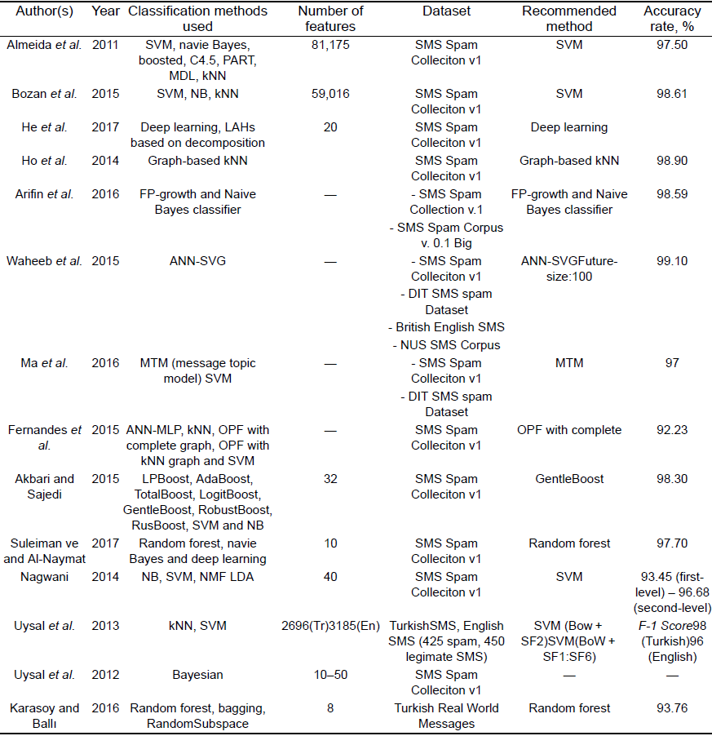
Examples of Past Spam Classification Studies
The table below shows a summary of years of previous SMS filtering and classification studies.

Slide 5
Word2vec Library
Word2vec was published by Google in 2013 as a deep learning based opensource tool. Thanks to this tool, words can be transformed into vectors and the distances between them can be calculated and an analogy can be established between the words. Word2vec is easy to understand and fast to train compared to other techniques. This technique is an easy to scale model that works with small and large datasets. Word2vec can find the semantic relationships between words in the sentence.
Examples made with the model consist of Google News texts, as shown in Fig. 1 (slide 6), the words that are similar to each other are represented by close vectors. For example, dog and cat are represented in the areas close to each other. In addition, relations between words present close associations also in similar word phrases. Therefore, the relationship between ‘fast’, ‘faster’ and ‘fastest’ is similar to ‘long’, ‘longer’ and ‘longest’. Using the model created with Word2vec, the similarities of the words can be reached. In the model created with Google news, the closest word to ‘Man’ is ‘Woman’ (with a similarity value of 0.69). In a certain group of words, it can distinguish the irrelevant word with doesn’t match function. The command doesn’t match (‘blue red green yellow book’) returns the word ‘book’ in response.
Word2vec has a two-layer neural network that processes texts. CBOW and Skip-Gram are the main learning modes used in Word2vec. Fig. 2 (slide7) shows the working principles of CBOW and Skip-Gram algorithms. The CBOW model is used to predict contexts (neighboring words) according to the word, and the Skip-Gram is used to predict the word from contexts.

Slide 6
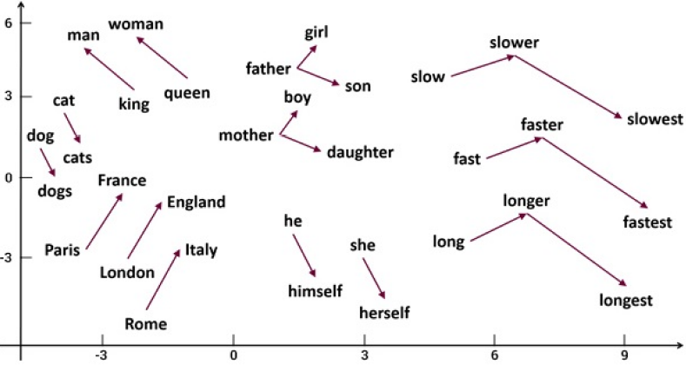
How Word2vec maps vectors
Figure – 1 Semantic Relations in Vector Space

Slide 7
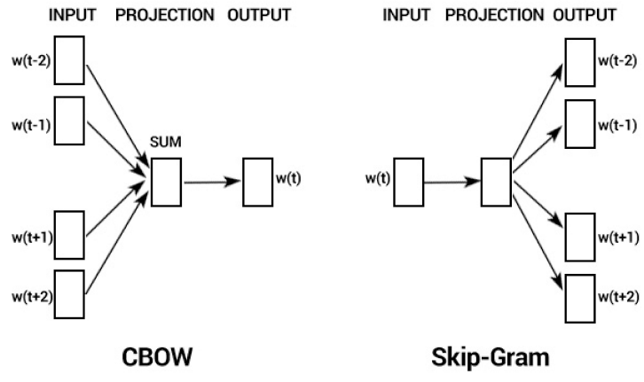
Word2vec Learning Modes
Figure – 2 How CBOW and Skip-Gram models' function

Slide 8
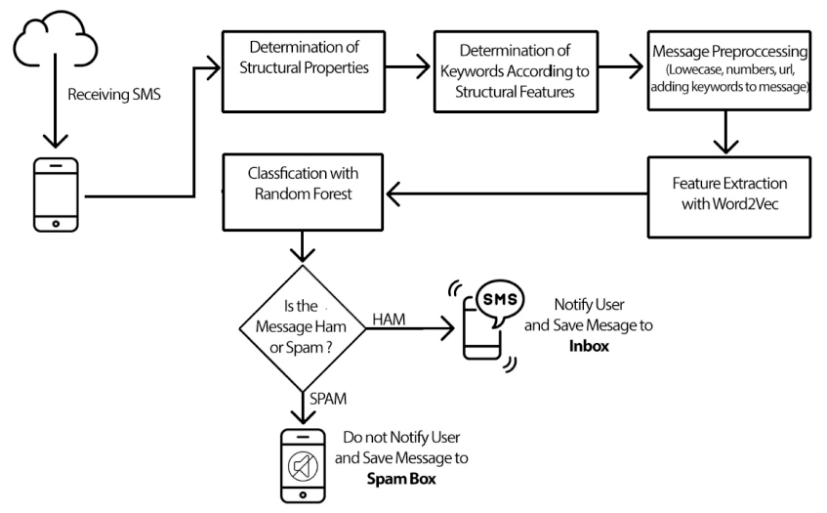
Introduction
For this project, the model is built by using five different supervised machine learning methods. Random forest, Naïve Bayes, MLP, logistic regression and SVM were used. These machine learning methods below are chosen because they are frequently used in text classification and have successful accuracy rates in other studies. The flowchart below shows how the proposed system works.

Slide 9
Dataset
SMS Spam Collection dataset is used in this study. There are two classes in this dataset: spam and ham. Spam is described as unwelcome messages sent with the aim of commercial benefit or simply causing detriment or discomfort to users. Ham has generally desired messages like daily messaging among people. The dataset consists of 5574 lines of short messages consisting of 4827 ham and 747 spam messages. About 70% of the dataset is reserved for testing and 30% for training.
For ease it is determined by the features such as message length (ML), capital letters (CWR), emotional expression frequency (Emoji) and URL, which can help in classification.
The Spam Message Weight (SMW) value of each message is calculated by adding word scores according to the present status of these selected words in the messages. Figure 3 (slide 10) shows examples of the values of the structural properties of the messages.

Slide 10
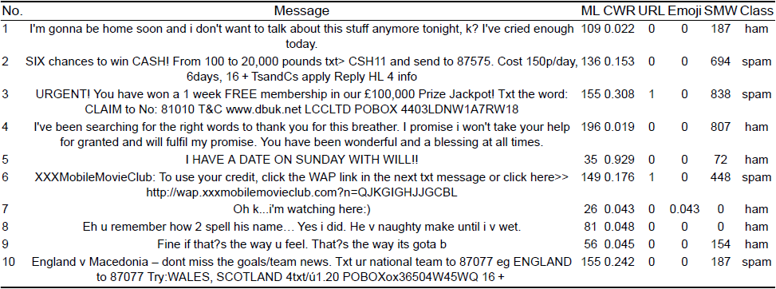
Data Pre-processing
Figure – 3 Features used to determine structural features of messages

Slide 11
Transforming Structural Features to Keywords
Structural features in the proposed solution are to be added to the messages as text and analogies are to be established with these texts and the words in the messages. The keywords added to messages according to their structural characteristics are below,
ML - MiniMessage, MaxiMessage
CWR - MiniUpperCase, MidiUpperCase, MaxiUpperCase
URL - HasURL, NoURL
Emoji - HasEmoji, NoEmoji
SMW - MiniSpam, MaxiSpam

Slide 12
Modified Dataset
In order to create the Word2Vec model, the dataset is modified with the steps in Figure - 4. Firstly, the digits, punctuation marks and symbols are removed from the dataset.
All characters are translated into lower case and URLs are removed from the message.
The class of the message is added to the beginning and end of the message to create a strong connection with the words.
The keywords that specify the structural characteristics of the message are added to the end of the message.

Slide 13
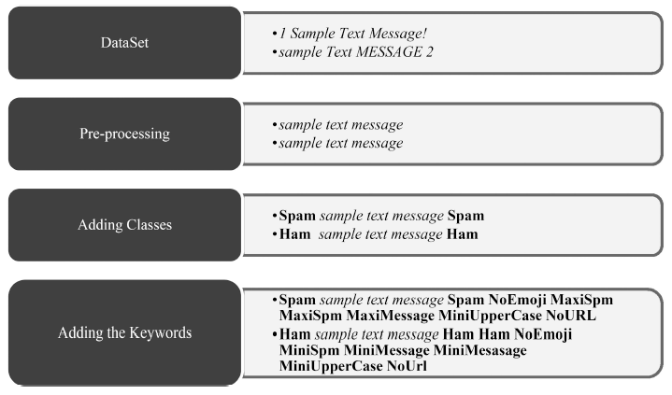
New Dataset Creation
Figure 4 – New Dataset created with Keywords

Slide 14
Feature Extraction with Word2vec
Word2Vec model is created after the preliminary processes. Using this model, distance values of the words of each message to spam and ham keywords are calculated by Word2vec. Two new features are created by adding these values separately according to the classes.
Figure – 5 (slide 15) shows how distances to spam and ham keywords are calculated for a selected sample message. A feature of each word in the message is created by founding and adding distances of each word from keywords. If a word which is not in the model is included in the message, its distance to the keywords is 0 and it is excluded. Since the word ‘jackpot’ is not in the dictionary, the letters such as ‘t’, ‘c’, ‘a’ are not processed because they are single characters.
Figure – 6 (slide16) shows ten sample records from the final state of the dataset prepared for use in the classification.
Figure - 7 (slide 17) shows the distribution of w2vSpam and w2vHam features.

Slide 15
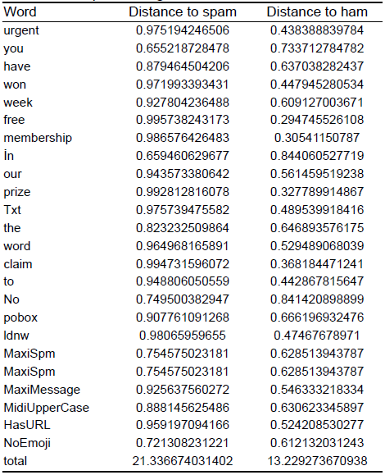
Sample Message
Figure 5 - Feature Extracted from a sample message

Slide 16
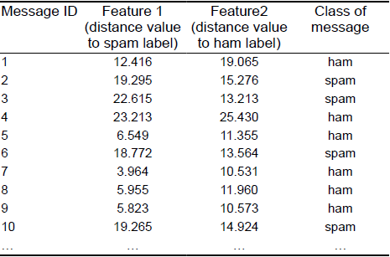
Classification Dataset
Figure 6 – Dataset for classification

Slide 17
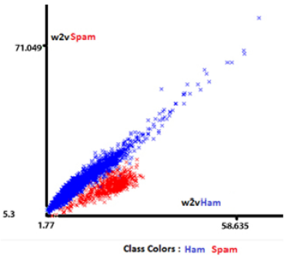
Distribution of Ham and Spam
Figure 7 – Distribution of features created

Slide 18
Classification
In the classification phase, keywords are determined according to the structural features of the incoming SMS. This message is then passed through a preliminary process.
The message text is converted into lower cases. Numbers, punctuation and URLs are removed from the message, and the specified keywords are added to the message. With the Word2Vec model prepared in the study, two new features are found by adding the distances of the words of the message to spam and ham. These features are classified with the help of classification algorithm.
The message classified according to the model designed in (Slide 8), is sent to the Spam box without notifying the user. If the incoming message is classified as ham, the user is cautioned and the message is moved to the inbox.

Slide 19
Method
The performed study is carried out in two stages with the creation of Word2Vec model and classification algorithm.
The Word2Vec model is prepared in Python with the Gensim library.
Classification procedures are performed using Weka program.
Figure – 8 (slide 20) shows the results reached by random forest, MLP, SVM, logistic regression and Naive Bayes algorithms using two different methods for feature extraction.

Slide 20
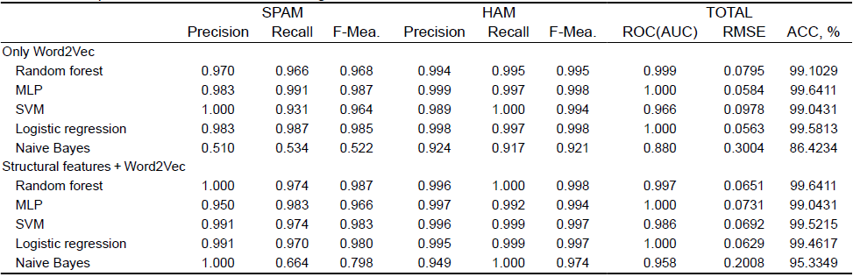
Results
Figure 8 – Classification Algorithms compared

Slide 21
Evaluation Metrics and Discussion
Precision, F-measure, Recall, Roc and Accuracy parameters are examined while evaluating the classification algorithms. Although accuracy (ACC) is the ratio of correct estimations to all estimations, it is not sufficient alone to evaluate the work. For this reason, Precision, Recall, F-measure, ROC and RMSE values are also examined.
From Figure – 8 (slide 20), only Word2Vec part shows the results reached by the features found only by calculating distances of words to the types (spam, ham) without considering the structural features of the message (message length, URL status etc.).
From Figure – 8 (slide 20), MLP has the best correct accuracy rate with 99.64% in only Word2Vec part. In Figure – 8 (slide 20), structural features + Word2Vec part shows the results of the classification algorithms which are compared according to the distance values of the words (to the types) in the message after the structural properties of the message are added to the message as a keyword.
In Figure – 8 (slide 20), random forest has the best accuracy rate with 99.64%.

Slide 22
Conclusion
In this study, a content-based classification solution is proposed to prevent spam SMS which is an important problem nowadays. Unlike previous studies, the proposed model in this study uses semantic relationships between words in the SMS message. Words in the message are transformed into vectors and the distances between them are calculated and an analogy is established between the words by using Word2Vec.
Keywords are determined according to the structural properties of the messages in the dataset and then new dataset is created by adding these keywords to the dataset. The Word2Vec model is constructed from the newly created dataset formed with Word2Vec library and the features are extracted for each message with the help of this model. Using the generated features, common classification successes of learning algorithms in previous studies are examined.
In conclusion, the random forest is selected as the best method with the accuracy rate of 99.6411%. Considering the previous studies performed with the same dataset, it is observed that the method proposed in this study achieved more successful and statistically significant results in the correct classification percentage. The proposed approach can be integrated into existing SMS applications to detect spam SMS.

Slide 23
Future Work
The project is still far from finish. Work needs to be done still on the evaluation metrics and the data obtained here for accuracy needs to further compared to existing newer methods and algorithms.
Furthermore,\, tuning the input parameters of the classification algorithms would be convenient, also it would be advantageous to carry out the cross-validation of the developed models.

Slide 24
Thanks !
Thanks Dr. A and everyone for bearing with me. I learnt a lot in this class, and I believe this very helpful in the future for me in my field of study. I wish all of you guys a very happy summer breaks.

